Slide 1
Auto-Encoders, and VAE
Amos Azaria

Slide 2
Deep Learning Classification General Architecture
Input
Conv layer 1 + Max Pooling
Conv layer 2 + Max Pooling
…
Fully Connected 1
Fully Connected2
…
Softmax
Output
(loss is calculated from label)

Slide 3
Auto-Encoder General Idea
Input
Encoder and decoder can be fully-connceted, cov-based, or even RNN based.
Encoder
Decoder
Bottleneck = encoding
Output
Loss is calculated from Input!

Slide 4
Auto-Encoders
Auto-encoders use the input as their label; therefore, they do not require any labeling.
A problem which does not require labeling is called unsupervised (as opposed to supervised learning which is what we have done until now).
Labeled data is usually what is expensive (usually manually labeled) therefore it is usually much easier to get unlabeled data.

Slide 5

Auto-Encoders' Code (embedding)
AutoEncoders can be used for images, audio, video etc. For example:
Digit images (mnist): code might include the digit but also it's type. E.g. 4 is different than . Code might include additional information: digit width, digit location, digit roundability…
Animals: code might include the animal, it's size, gender, etc.
Music: code might include music type, volume, etc.
The code from the auto encoder should hold the essence of the data. It might be used as a compression of it.

Slide 6
Auto-Encoders' Code (cont.)
Code may be useful for image search, with no need for any human labeling.
Encodings can be used also for clustering the data (without labels)
We may think of this code as an embedding from one feature space (pixels) to another (the code).
Two images of the same cat at a different angle, should have similar encodings.
Similarly, two images of mugs which are identical with all features except the color should also map to close vectors.
Red Table – Green Table + Green Mug =
Red Mug!

Slide 7
Auto-Encoder for Mnist (encoder: exactly as we've seen previously)
import numpy as np import tensorflow as tf from tensorflow.examples.tutorials.mnist import input_data from matplotlib import pyplot as plt mnist = input_data.read_data_sets("MNIST_data/", one_hot=True) x = tf.placeholder(tf.float32, shape=[None, 784]) #y_ = tf.placeholder(tf.float32, shape=[None, 10]) #we don't provide the labeles! W_conv1 = tf.Variable(tf.truncated_normal([5, 5, 1, 32], stddev=0.1)) b_conv1 = tf.Variable(tf.constant(0.1, shape=[32])) x_image = tf.reshape(x, [-1,28,28,1]) #if we had RGB, we would have 3 channels h_conv1 = tf.nn.relu(tf.nn.conv2d(x_image, W_conv1, strides=[1, 2, 2, 1], padding='SAME') + b_conv1) W_conv2 = tf.Variable(tf.truncated_normal([5, 5, 32, 64], stddev=0.1)) b_conv2 = tf.Variable(tf.constant(0.1, shape=[64])) h_conv2 = tf.nn.relu(tf.nn.conv2d(h_conv1, W_conv2, strides=[1, 2, 2, 1], padding='SAME') + b_conv2) W_fc1 = tf.Variable(tf.truncated_normal([7 * 7 * 64, 1024], stddev=0.1)) b_fc1 = tf.Variable(tf.constant(0.1, shape=[1024])) h_pool2_flat = tf.reshape(h_conv2, [-1, 7*7*64]) h_fc1 = tf.nn.relu(tf.matmul(h_pool2_flat, W_fc1) + b_fc1) W_fc2 = tf.Variable(tf.truncated_normal([1024, 10], stddev=0.1)) b_fc2 = tf.Variable(tf.constant(0.1, shape=[10]))
code = tf.nn.softmax(tf.matmul(h_fc1, W_fc2) + b_fc2)

Slide 8
Auto-Encoder for Mnist (decoder: fully connected)
feed_code = tf.placeholder(tf.float32, shape=[None, 10])
W_dfc2 = tf.Variable(tf.truncated_normal([10, 1024], stddev=0.1))
b_dfc2 = tf.Variable(tf.constant(0.1, shape=[1024]))
h_dfc2 = tf.nn.relu(tf.matmul(code, W_dfc2) + b_dfc2)
h_dfc2_feed = tf.nn.relu(tf.matmul(feed_code, W_dfc2) + b_dfc2)
W_dfc1 = tf.Variable(tf.truncated_normal([1024, 28*28], stddev=0.1))
b_dfc1 = tf.Variable(tf.constant(0.1, shape=[28*28]))
x_dimage = tf.nn.relu(tf.matmul(h_dfc2, W_dfc1) + b_dfc1)
x_dimage_feed = tf.reshape(tf.nn.relu(tf.matmul(h_dfc2_feed, W_dfc1) + b_dfc1), [-1,28,28])
Note that the decoder has only 2 fully connected layers. We could have added deconvolution layers (conv2d_transpose).
There are also autoencoders that share the same weights between encoder and decoder

Slide 9
Auto-Encoder for Mnist (training: same as before but no labels)
loss = tf.reduce_mean(tf.pow(x - x_dimage,2)) update = tf.train.AdamOptimizer(1e-4).minimize(loss)
sess = tf.InteractiveSession() sess.run(tf.global_variables_initializer()) for i in range(10000): batch = mnist.train.next_batch(50) if i%100 == 0: curr_loss = loss.eval(feed_dict={x:batch[0]}) print("step %d, loss %g"%(i, curr_loss)) update.run(feed_dict={x: batch[0]})

Slide 10
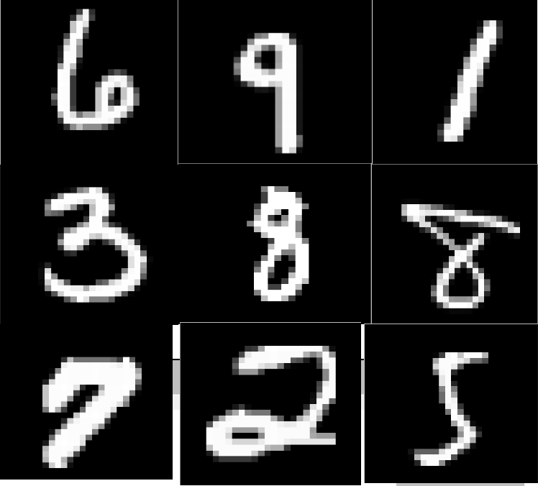
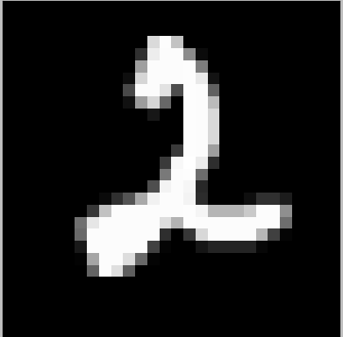
Results
[ 0.03 0.08 0.10 0.09 0.13 0.04 0.36 0.05 0.01 0.11]
[ 0.11 0.16 0.01 0.03 0.25 0.19 0.23 0.002 0.01 0.008]
[ 0.04 0.002 0.03 0.012 0.39 0.1 0.003 0.1 0.31 0.007]
[ 0.28 0.065 0.05 0.25 0.1 0.003 0.12 0.04 0.09 0.013]
[ 0.23 0.048 0.11 0.04 0.22 0.08 0.12 0.09 0.02 0.04]
[ 0.1 0.13 0.005 0.1 0.11 0.16 0.1 0.15 0.09 0.05]
[ 0.13 0.02 0.13 0.08 0.004 0.27 0.06 0.2 0.07 0.03 ]
[ 0.03 0.03 0.14 0.11 0.04 0.001 0.12 0.23 0.02 0.27]
[ 0.15 0.04 0.09 0.06 0.25 0.09 0.01 0.04 0.02 0.25]
[ 0.15 0.07 0.12 0.04 0.10 0.008 0.17 0.23 0.08 0.04]

Slide 11
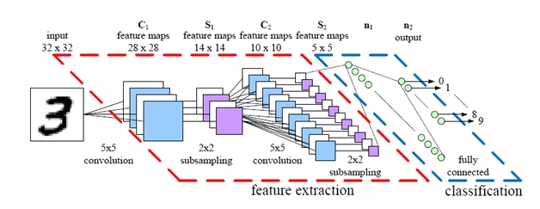
Embedding Obtained From a Classifier
We can also use one of the layers of a neural network as the encoding (usually the one before last layer).
The neural network's original use may be classification or regression.
This layer can be our embedding
Credit: parse.ele.tue.nl

Slide 12
Denoised Auto-Encoder
Noised(!) Input
Encoder
Decoder
Bottleneck = encoding
Output
Loss is calculated from original (unnoised) input!

Slide 13
Semi-Supervised Learning With Auto-Encoders
Auto-Encoders have had some (partial) success in semi-supervised learning.
For example, suppose one has labels for only 100 digits, but the whole unlabeled dataset.
An auto encoder can be built using the whole unlabeled data-set, and then based upon the trained model, the decoder is replaced with a supervised learner.
The first level weights are left untouched, and the supervised learner only manipulates the last layer(s).
Another option is to use nearest neighbor for the last layer (and leave all weights unchanged).
A paper from 2015 ("Semi-supervised learning with ladder networks"), has achieved ~99% accuracy rate with just 100 labeled digits in the Mnist dataset, based upon a variant of a denoised-auto-encoder.

Slide 14
Generating Data!
What happens if we sample a random vector and just decode it?
We will get data that might look real!
How do we sample this vector (what is the distribution)?

Slide 15
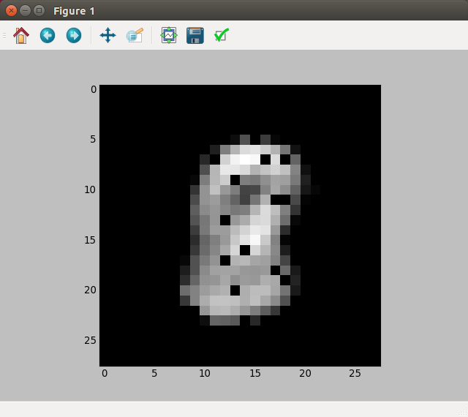
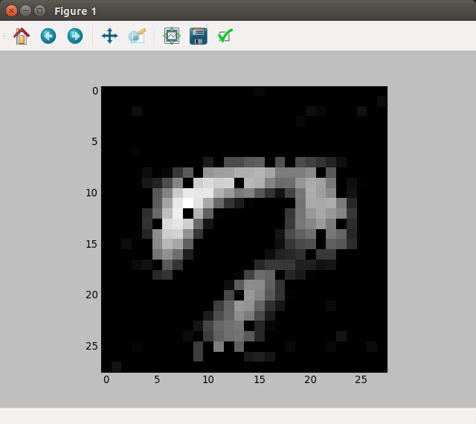
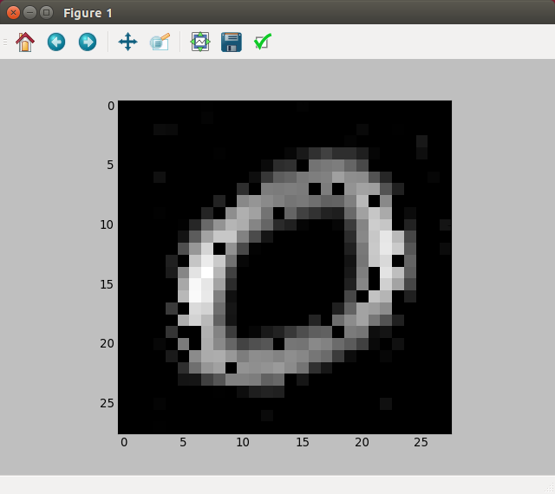
Generating Data Example
[img1] = sess.run(x_dimage_feed, feed_dict={feed_code:[[1, 0, 0, 0, 0, 0, 0, 0, 0, 0]]}) plt.imshow(img1, interpolation='nearest', cmap='gray') plt.show() [img2] = sess.run(x_dimage_feed, feed_dict={feed_code:[[.1, .1, .1, .1, .1, .1, .1, .1, .1, .1]]}) plt.imshow(img2, interpolation='nearest', cmap='gray') plt.show() [img3] = sess.run(x_dimage_feed, feed_dict={feed_code:[[0.5, 0, 0, 0.5, 0, 0, 0, 0, 0, 0]]}) plt.imshow(img3, interpolation='nearest', cmap='gray') plt.show()

Slide 16
Variational Auto-Encoder (VAE)
Used for generating data.
Input
Encoder
encoding
mean
encoding
std
Encoding is sampled from a Gaussian with mean = encoding mean, and std = encoding std.
Decoder
sampled encoding
Output
Loss is calculated from Input + KL.

Slide 17

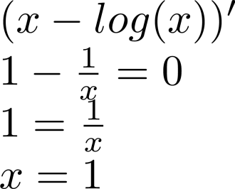

Loss Function
The encoder can "skip" the sampling stage by assigning 0 to all standard deviations.
We add the KL divergence metric to the loss term to avoid that:
Assuming input is of size K (features or pixels):
KL divergence metric (J is encoding length):
For a mini-batch of size M, we get:
What values will minimize this term?
Notes:
KL = Kullback-Leibler
mu = 0, var/std = 1
I have seen both reduce_sum and reduce_mean for the regular loss function.

Slide 18
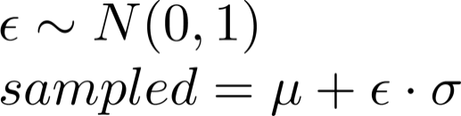
Sampling
In order to be able to compute the gradient and update, we need differentiable and deterministic functions.
Therefore, instead of sampling according to the actual distribution, we sample noise, and then add it (multiplied by std) to the average.

Slide 19
VAE Preamble
import tensorflow as tf
import numpy as np
import matplotlib.pyplot as plt
from tensorflow.examples.tutorials.mnist import input_data
mnist = input_data.read_data_sets('MNIST_data')
tf.reset_default_graph()
batch_size = 64
X_in = tf.placeholder(dtype=tf.float32, shape=[None, 28, 28], name='X')
Y = tf.placeholder(dtype=tf.float32, shape=[None, 28, 28], name='Y')
Y_flat = tf.reshape(Y, shape=[-1, 28 * 28])
keep_prob = tf.placeholder(dtype=tf.float32, shape=(), name='keep_prob')
code_len = 8
def lrelu(x, alpha=0.3):
return tf.nn.leaky_relu(x, alpha=alpha)
def plot_figures(figures, nrows = 1, ncols=1):
fig, axeslist = plt.subplots(ncols=ncols, nrows=nrows)
for ind,title in enumerate(figures):
axeslist.ravel()[ind].imshow(figures[title], cmap=plt.gray())
axeslist.ravel()[ind].set_title(title)
axeslist.ravel()[ind].set_axis_off()
plt.tight_layout()
plt.show()
We define a new leaky ReLU function, so that we can set the alpha to 0.3 (the default is 0.2).
Code based on: https://towardsdatascience.com/teaching-a-variational-autoencoder-vae-to-draw-mnist-characters-978675c95776

Slide 20
VAE Encoder
def encoder(X_in, keep_prob_e):
with tf.variable_scope("encoder", reuse=None):
X = tf.reshape(X_in, shape=[-1, 28, 28, 1])
x = tf.layers.conv2d(X, filters=64, kernel_size=4, strides=2, padding='same', activation=lrelu)
x = tf.nn.dropout(x, keep_prob_e)
x = tf.layers.conv2d(x, filters=64, kernel_size=4, strides=2, padding='same', activation=lrelu)
x = tf.nn.dropout(x, keep_prob_e)
x = tf.layers.conv2d(x, filters=64, kernel_size=4, strides=1, padding='same', activation=lrelu)
x = tf.nn.dropout(x, keep_prob_e)
x = tf.contrib.layers.flatten(x)
mn_e = tf.layers.dense(x, units=code_len)
log_var_e = tf.layers.dense(x, units=code_len)
return mn_e, log_var_e
Note the short functions usage (no weight definitions, no mention of input sizes)

Slide 21
VAE Decoder
def decoder(sampled_z, keep_prob_d):
with tf.variable_scope("decoder", reuse=None):
x = tf.layers.dense(sampled_z, units=24, activation=lrelu)
x = tf.layers.dense(x, units=49, activation=lrelu)
x = tf.reshape(x, [-1, 7, 7, 1])
x = tf.layers.conv2d_transpose(x, filters=64, kernel_size=4, strides=2, padding='same', activation=tf.nn.relu)
x = tf.nn.dropout(x, keep_prob_d)
x = tf.layers.conv2d_transpose(x, filters=64, kernel_size=4, strides=1, padding='same', activation=tf.nn.relu)
x = tf.nn.dropout(x, keep_prob_d)
x = tf.layers.conv2d_transpose(x, filters=64, kernel_size=4, strides=1, padding='same', activation=tf.nn.relu)
x = tf.contrib.layers.flatten(x)
x = tf.layers.dense(x, units=28 * 28, activation=tf.nn.sigmoid)
img_d = tf.reshape(x, shape=[-1, 28, 28])
return img_d
Conv2d_transpose is a method of adding excessed padding (0's) so that the resulting output is much larger than the input (up-sampling). When the original convolution would have stride of 2 (or more), we add padding (0's) between the original pixels (and obviously do convolution with stride of 1). See some animations here: https://github.com/vdumoulin/conv_arithmetic

Slide 22
VAE Encoder-Decoder Connection (Sampling)
mn, log_var = encoder(X_in, keep_prob)
epsilon = tf.random_normal(tf.stack([tf.shape(X_in)[0], code_len]))
sampled = mn + tf.multiply(epsilon, tf.exp(0.5 * log_var))
dec = decoder(sampled, keep_prob)
flattened = tf.reshape(dec, [-1, 28*28])
img_loss = tf.reduce_sum(tf.squared_difference(flattened, Y_flat), 1)
KL_loss = -0.5 * tf.reduce_sum(1.0 + log_var - tf.square(mn) - tf.exp(log_var), 1)
loss = tf.reduce_mean(img_loss + KL_loss)
update = tf.train.AdamOptimizer(0.0005).minimize(loss)

Slide 23
Train and Image Generation
sess = tf.Session()
sess.run(tf.global_variables_initializer())
for i in range(10000):
batch = [np.reshape(b, [28, 28]) for b in mnist.train.next_batch(batch_size=batch_size)[0]]
sess.run(update, feed_dict={X_in: batch, Y: batch, keep_prob: 0.8})
if i % 100 == 0:
ls, d, reg_ls, kl_ls, mu, lvar = sess.run([loss, dec, img_loss, KL_loss, mn, log_var],
feed_dict={X_in: batch, Y: batch, keep_prob: 1.0})
print(i, ls, np.mean(reg_ls), np.mean(kl_ls))
if i % 1000 == 0:
plot_figures({"original": np.reshape(batch[0], [28, 28]), "decoded": d[0]}, 1, 2)
randoms = [np.random.normal(0, 1, code_len) for _ in range(20)]
imgs = sess.run(dec, feed_dict = {sampled: randoms, keep_prob: 1.0})
imgs = [np.reshape(imgs[i], [28, 28]) for i in range(len(imgs))]
img_dict = {}
for (i, img) in enumerate(imgs):
img_dict["Image #" + str(i+1)] = img
plot_figures(img_dict, 4, 5)

Slide 24
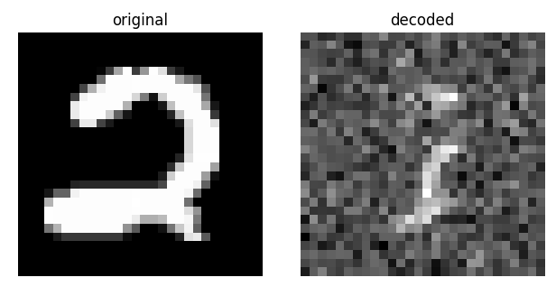
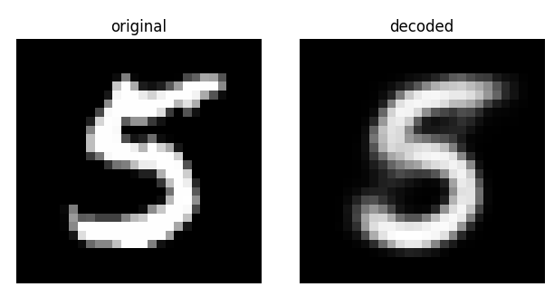
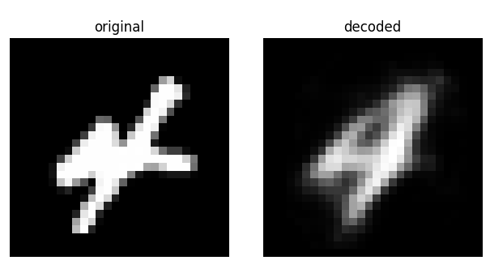
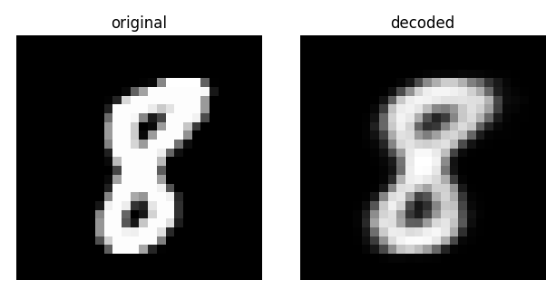
Images During Training
Images are soft, and closer to the average digit, to minimize the loss (note the slight diagonal line on the 5).

Slide 25
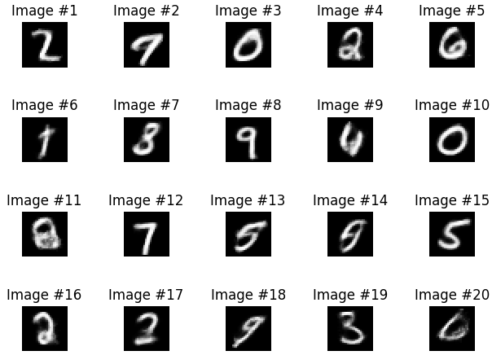
Randomly Generated Images

Slide 26
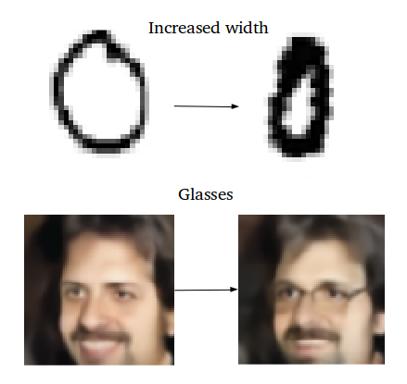
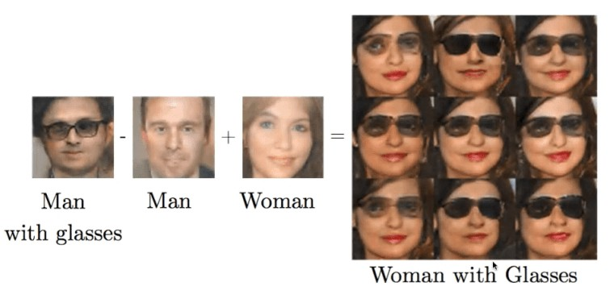
Adding and Subtracting Encodings

